Slide 1

EDUCATORS APPROACH
Integrating
Genetics & Genomics
Education into
Nursing Workforce
Clinical Practice

Slide 2
Why Genetics & Genomics
Continual evolution of technology, diagnoses and therapies
Recognized educational skills gap in healthcare
Directly translates to patient care (Translational Genomics and Personalized Medicine)
Nurses and the healthcare community must understand the clinical applications

Slide 3
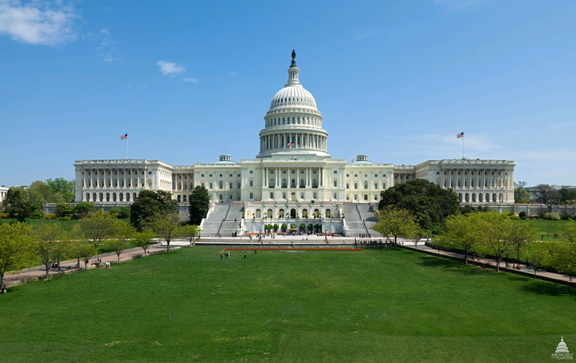

United States of America
State of the Union Address
January 20, 2015
“I want the country that eliminated polio and mapped the human genome to lead the
new era of medicine, one that delivers the right treatment at the right time.” - Barack Obama
Notes:
I quote the president, ” In some patients with cystic fibrosis, this approach has reversed a disease once thought unstoppable” The Precision Medicine Initiative was launched to bring us closer to curing disease.

Slide 4
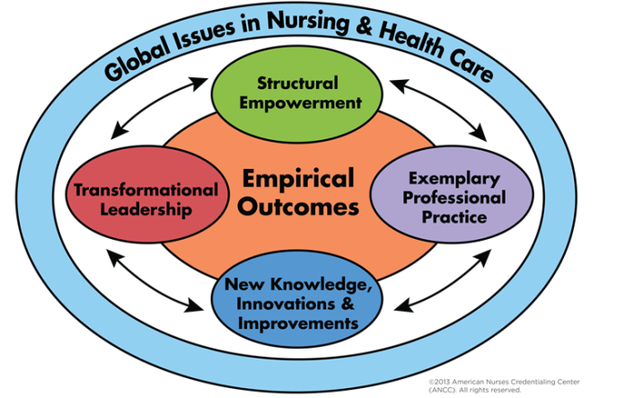
Genetic/Genomic Nursing:
Education and Translation into Practice
Notes:
American Nurses Credentialing Center

Slide 6
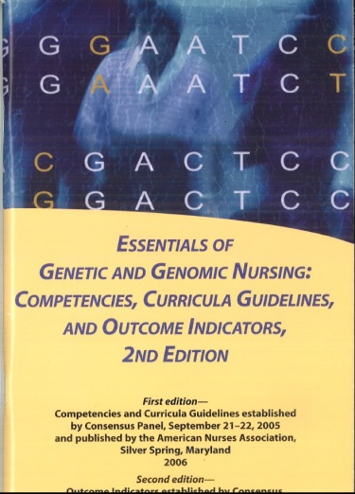
Facilitate Nurse Education & Involvement
Increase overall education of Genetics and Genomics
Abbreviated family history taking
Define a genetic referral process
Increase knowledge related to diagnostic testing
Discuss treatment options and implications

Slide 7
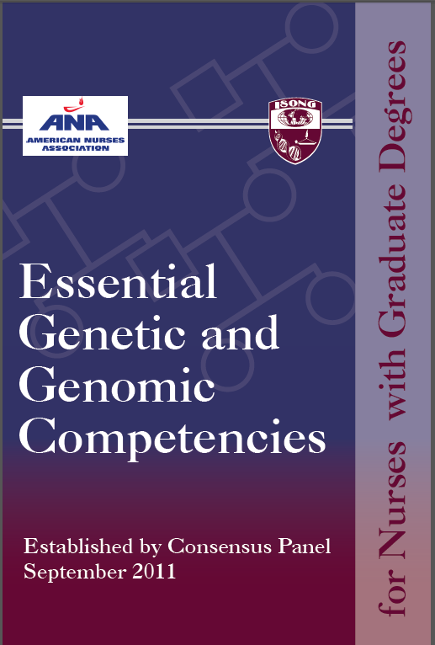
Competencies for
Advanced Practice Nurses
They are involved in the management of complex patient health care problems through direct care, consultation, education, and research
The advanced nurse practitioner can make important contributions and add sustainability of educational progress in the workplace

Slide 8
Assess Institutional Environment
Identify where genetics/genomics is directly relevant to your patient populations and outcomes
  Sickle cell
  Diabetes
  Cystic fibrosis
  Cancer
  Direct-to-consumer genetic testing
  Newborn screening
  Medication reactions
Collaborate clinical experts and institutional leaders to confirm current resource
  Genetic counselors/Geneticists
  Molecular genetic laboratories
  Researchers
  Advance practice nurses
Survey staff to establish need and readiness for education
  Link to the survey tool

Slide 9
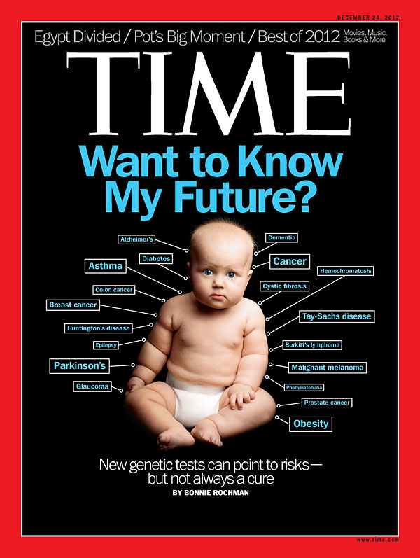

Slide 10
Build a Plan
Present a framework for training and education
Use champions to assist with idea development, training and sustaining the plan
Integrate plan into you institutional goals:
  MAGNET submissions
  Clinical Advancement Ladder
  Process Improvement
  Nursing Research (IRB, Survey, Intervention, Outcomes)

Slide 11
MAGNET Document Support
NK2: Nurses disseminate the organization's nursing research findings to internal and external audiences.
NK8: Describe and demonstrate innovations in nursing practice.

Slide 12
Engage support from leadership
Nurse Leader Imperatives
Pamela Hinds, PhD, RN, FAAN Children’s National Health System, Washington, DC
Nurses prepared to respond to parent/patient questions so parent/patient language understood
Nurses able to assess family histories and make referrals
Nurses anticipating potential treatment reactions
Nurses able to participate in treatment discussions with colleagues

Slide 13
GOAL
SUPPORT
NURSES
IDENTIFY
EXISTING
KNOWLEDGE
MANAGEABLE
STEPS
PROVIDE
EASILY
ACCESIBLE
EDUCATION

Slide 14
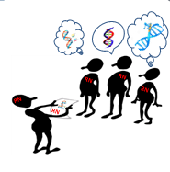
Conclusion
Relevant
To nursing practice
Resources
Abound
Readiness
Nurses ready and poised to lead the future

